Slide 1

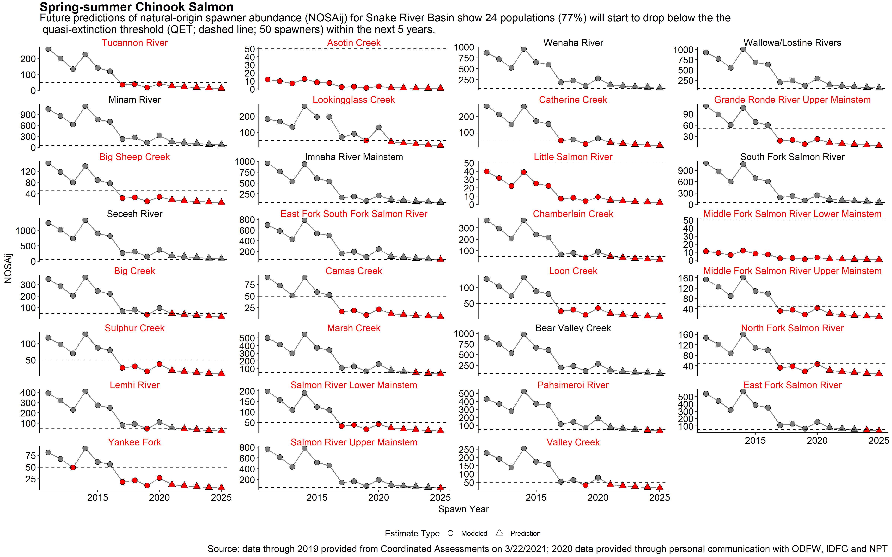

Snake Basin Chinook and Steelhead
Quasi-Extinction Threshold Alarm and Call to Action
42% of the Snake Basin spring/summer Chinook populations have natural origin spawner abundance currently at or below QET (50)
77% of the populations predicted to drop below critical level of 50 spawners by 2025
Snake Basin Chinook and Steelhead Quasi-Extinction Threshold Alarm and Call to Action
Presented to Northwest Power and Conservation Council May 5, 2021
Nez Perce Tribe Department of Fisheries Resources Management
“We are the circle. That’s what life is all about. We take care of one another. So when we have someone in trouble, that’s when the rest of us have to step in.”
—Elmer Crow, Nez Perce

Slide 2
What is Quasi-Extinction?
Abundance threshold for risk assessment and/or management intervention
Adult salmon abundance in a population nearing absolute extinction.
A state where the risk of extinction cannot be modeled but is considered to be unacceptably high.
A population that is uncertain to persist.
Probability of recovery low without substantial intervention.
Snake Basin Chinook and Steelhead Quasi-Extinction Threshold Alarm and Call to Action
Presented to Northwest Power and Conservation Council May 5, 2021
Nez Perce Tribe Department of Fisheries Resources Management

Slide 3
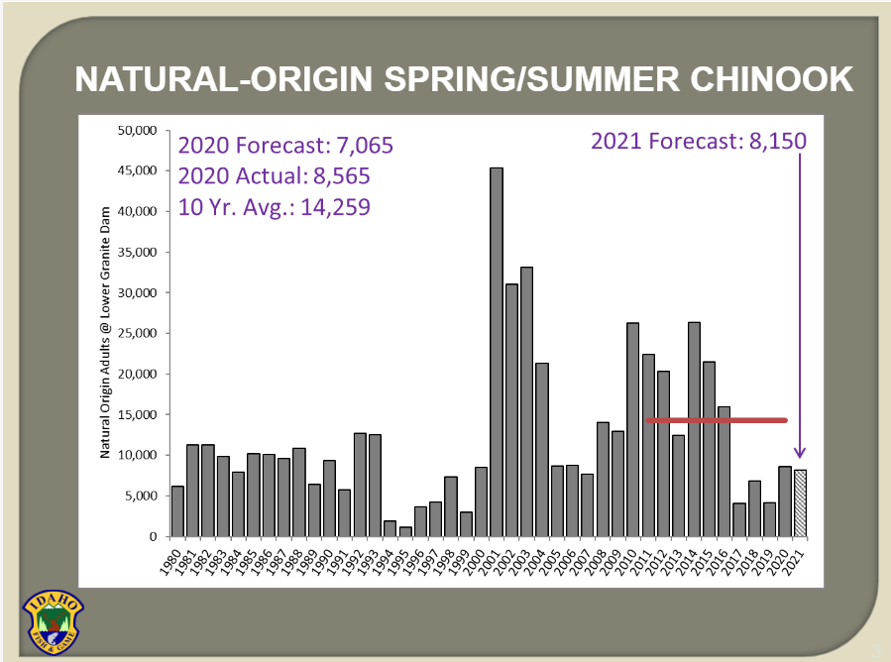
Snake River Salmon and Steelhead Returns
IDFG Presentation to NPCC March 2021
https://nwcouncil.app.box.com/s/h0iyex0w1oo9m98fv4hojmzv0qogibpi (Slide 3)
Snake Basin Chinook and Steelhead Quasi-Extinction Threshold Alarm and Call to Action
Presented to Northwest Power and Conservation Council May 5, 2021
Nez Perce Tribe Department of Fisheries Resources Management

Slide 4
Management Goals and Thresholds
Snake Basin Spring/summer Chinook Salmon
38 Extant (32 listed and 6 non-listed) Populations
    Desired - Healthy and Harvestable – CBP, NPCC
      Range from 2,000 to 8,000 per population.
      179,000 escapement at Lower Granite Dam, excluding blocked areas (235,000 with blocked areas).
      Aggregated values for Snake Basin populations = 121,000 (124,000 including Tucannon).
    Delisting – Minimum Abundance Threshold (MAT) – NOAA
      Range from 500 to 2,000 per population.
      Aggregated values for Snake Basin populations = 30,000 (29,250 at Lower Granite Dam).
    Critical - Quasi-Extinction Threshold (QET) - NOAA
      50 or fewer spawners within a population for four consecutive years.
      Aggregated values for Snake Basin populations = 1,900 (1,850 at Lower Granite Dam).
    Extirpation - Functionally Extinct or Absolute Extinction
      One or fewer adults in each year of cohort/generation
Snake Basin Chinook and Steelhead Quasi-Extinction Threshold Alarm and Call to Action
Presented to Northwest Power and Conservation Council May 5, 2021
Nez Perce Tribe Department of Fisheries Resources Management
Notes:
12020 CRS BiOp, Page 223, Section 2.2.3.1.12) Population abundance for four consecutive years used to estimate the probability of a population reaching a level which may be too small to effectively reproduce due to difficulty finding one another, risk from demographic stochasticity, genetic processes, and environmental variability. Value is greater than 1; 50 applied.

Slide 5
Desired = 179,000
Snake River Chinook Salmon Returns Relative to Aggregated Population Management Goals and Thresholds
Modified from IDFG March 2021 Presentation to NPCC
175,000
150,000
125,000
100,000
Snake Basin Chinook and Steelhead Quasi-Extinction Threshold Alarm and Call to Action
Presented to Northwest Power and Conservation Council May 5, 2021
Nez Perce Tribe Department of Fisheries Resources Management
75,000
Delisting = 29,250
Critical = 1,850
Notes:
CBP goal for Lower Granite NOR escapement is 235,000 (includes blocked areas). Actual CBP NOR abundance goal at Lower Granite adjusted for extant populations upstream of LGR is 179,000.

Slide 6








Population Specific Abundance
Data Sources and Attribution
  Spring/summer Chinook NOSAij (weir M/R and SGS surveys)
  - 1980-2019 - Coordinated Assessments
  - 2020 – Personal Communication with IDFG, ODFW, NPT
Results limited to 31 of 32 ESA listed spring/summer Chinook populations.
Asotin, Lookingglass, and Big Sheep creeks already classified as functionally extirpated.
Panther Creek and all Clearwater basin populations classified as extirpated.
Natural origin abundance data includes jacks.
Snake Basin Chinook and Steelhead Quasi-Extinction Threshold Alarm and Call to Action
Presented to Northwest Power and Conservation Council May 5, 2021
Nez Perce Tribe Department of Fisheries Resources Management

Slide 7
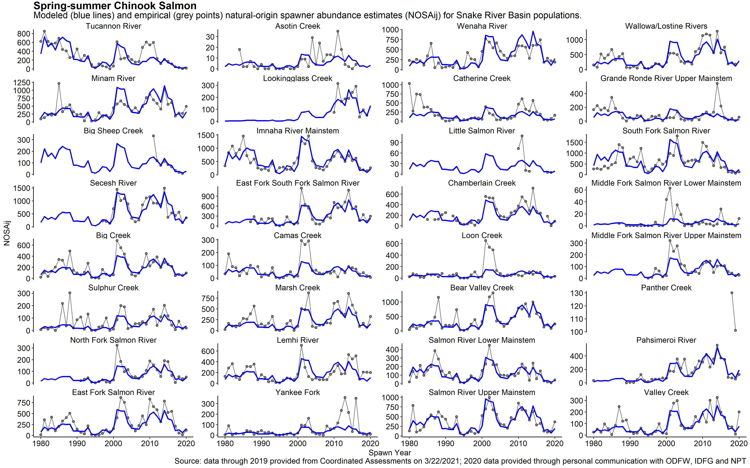
Abundance Fits Common Model
Spring/summer Chinook
Snake Basin Chinook and Steelhead Quasi-Extinction Threshold Alarm and Call to Action
Presented to Northwest Power and Conservation Council May 5, 2021
Nez Perce Tribe Department of Fisheries Resources Management

Slide 8
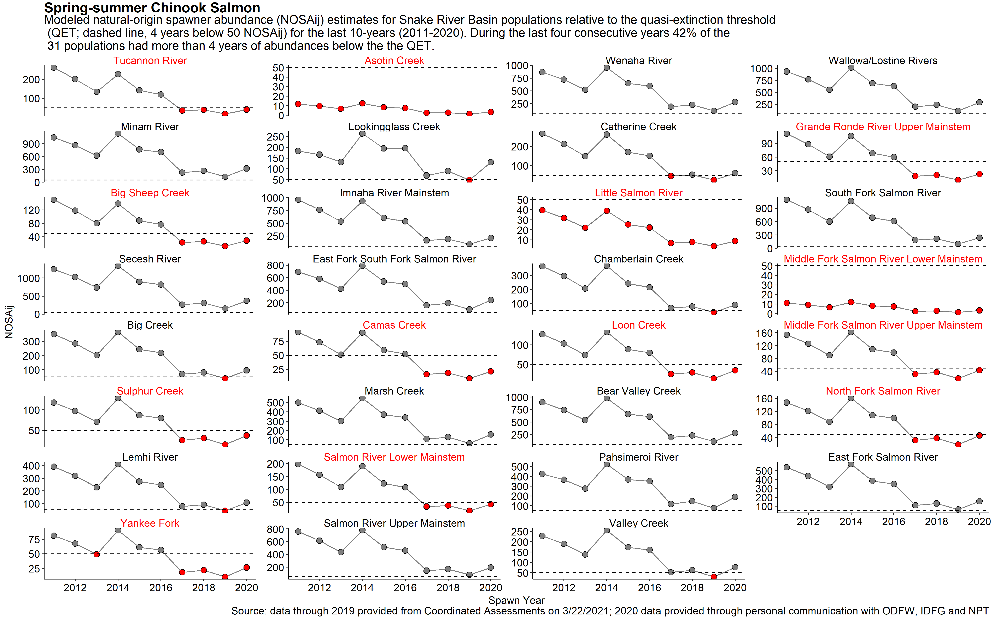
13 (42%) Spring/Summer Chinook Populations
Currently At or Below QET (50)
Snake Basin Chinook and Steelhead Quasi-Extinction Threshold Alarm and Call to Action
Presented to Northwest Power and Conservation Council May 5, 2021
Nez Perce Tribe Department of Fisheries Resources Management
Notes:
5 additional populations dropped below 50 NOR spawnners in at least one year since 2017. 19/31

Slide 9
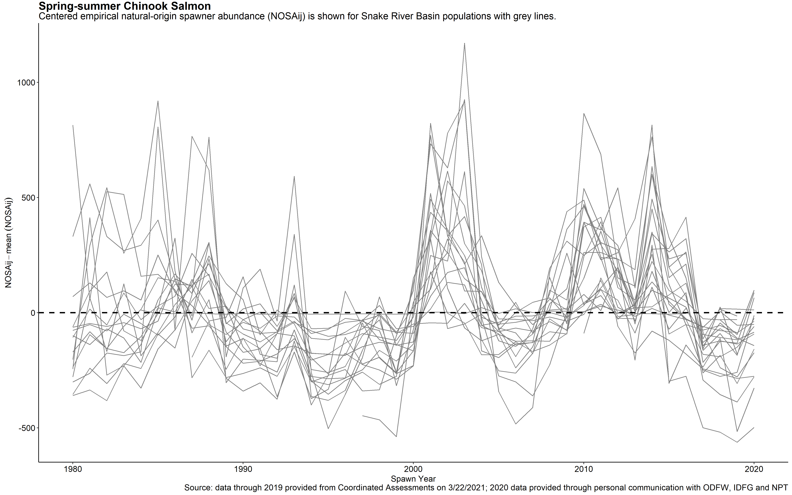
Synchrony Across Populations
Spring/summer Chinook
Snake Basin Chinook and Steelhead Quasi-Extinction Threshold Alarm and Call to Action
Presented to Northwest Power and Conservation Council May 5, 2021
Nez Perce Tribe Department of Fisheries Resources Management

Slide 10
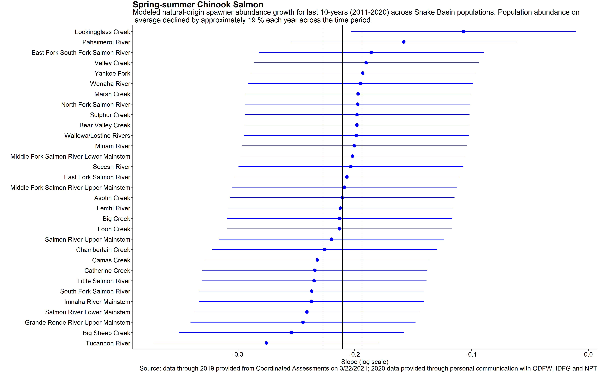
Abundance Declining 19% Each Year
Spring/summer Chinook
Snake Basin Chinook and Steelhead Quasi-Extinction Threshold Alarm and Call to Action
Presented to Northwest Power and Conservation Council May 5, 2021
Nez Perce Tribe Department of Fisheries Resources Management

Slide 11
24 (77%) Spring/Summer Chinook Populations
Predicted to be at or Below 50 spawners by 2025
Snake Basin Chinook and Steelhead Quasi-Extinction Threshold Alarm and Call to Action
Presented to Northwest Power and Conservation Council May 5, 2021
Nez Perce Tribe Department of Fisheries Resources Management

Slide 12
Management Goals and Thresholds
Snake Basin Steelhead
25 Extant (all ESA listed) Populations
    Desired - Healthy and Harvestable - CBP
      Range from 2,500 to 7,500 per population.
      137,480 escapement at Lower Granite, excluding blocked areas.
      Aggregated values for Snake Basin populations = 105,000 (100,000 at Lower Granite Dam).
    Delisting – Minimum Abundance Threshold (MAT) – NOAA
      Range from 500 to 1,500 per populations.
      Aggregated values for Snake Basin populations = 21,500 (20,000 at Lower Granite Dam).
    Critical - Quasi-Extinction Threshold (QET) - NOAA
      50 or fewer spawners within a population for four consecutive years.
      Aggregated values for Snake Basin populations = 1,250 (1,200 at Lower Granite Dam).
    Extirpation - Functionally Extinct or absolute Extinction
      One or fewer adults in each year of cohort/generation
Snake Basin Chinook and Steelhead Quasi-Extinction Threshold Alarm and Call to Action
Presented to Northwest Power and Conservation Council May 5, 2021
Nez Perce Tribe Department of Fisheries Resources Management
Notes:
12020 CRS BiOp, Page 223, Section 2.2.3.1.12) Population abundance for four consecutive years used to estimate the probability of a population reaching a level which may be too small to effectively reproduce due to difficulty finding one another, risk from demographic stochasticity, genetic processes, and environmental variability. Value is greater than 1; 50 applied.

Slide 13
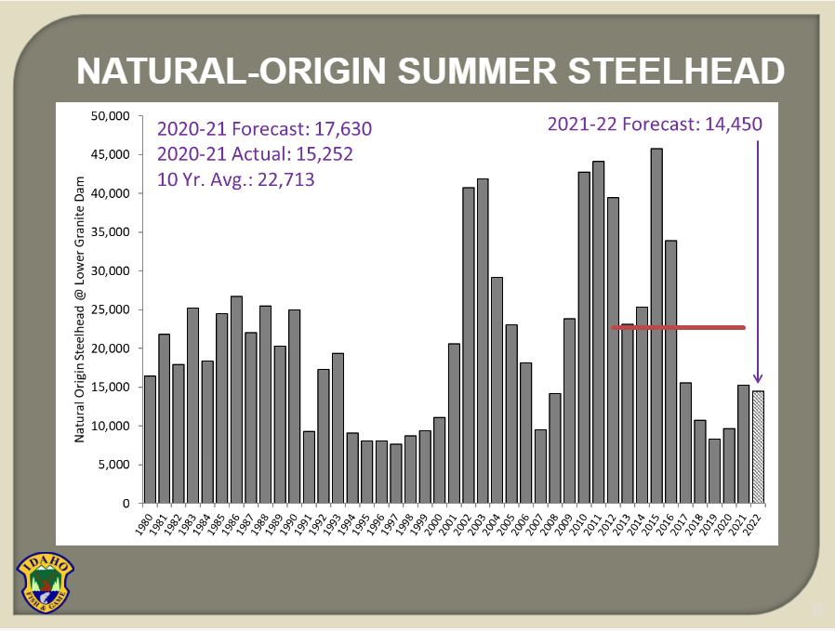
Snake River Steelhead
Returns Relative to Aggregated Population Management Goals and Thresholds
Modified from IDFG March 2021 Presentation to NPCC
Desired = 137,480
125,000
100,000
75,000
Snake Basin Chinook and Steelhead Quasi-Extinction Threshold Alarm and Call to Action
Presented to Northwest Power and Conservation Council May 5, 2021
Nez Perce Tribe Department of Fisheries Resources Management
Delisting = 20,000
Critical = 1,200

Slide 14
Population Specific Abundance
Data Sources and Attribution
Summer Steelhead (STADEM and DABOM)
  - 2010-2019 - Coordinated Assessments
  - 2020 – Personal Communication with NPT
Results limited to 16 of the 25 extant ESA listed steelhead populations.
No data for two populations (Chamberlain Creek and Middle Fork Salmon Upper Mainstem).
Six populations lack sufficient data (East Fork Salmon River, Grande Ronde Lower Mainstem, Lochsa River, North Fork Salmon River, Panther Creek, and Selway River).
Assessment limited to anadromous form of O. mykiss.
Snake Basin Chinook and Steelhead Quasi-Extinction Threshold Alarm and Call to Action
Presented to Northwest Power and Conservation Council May 5, 2021
Nez Perce Tribe Department of Fisheries Resources Management

Slide 15
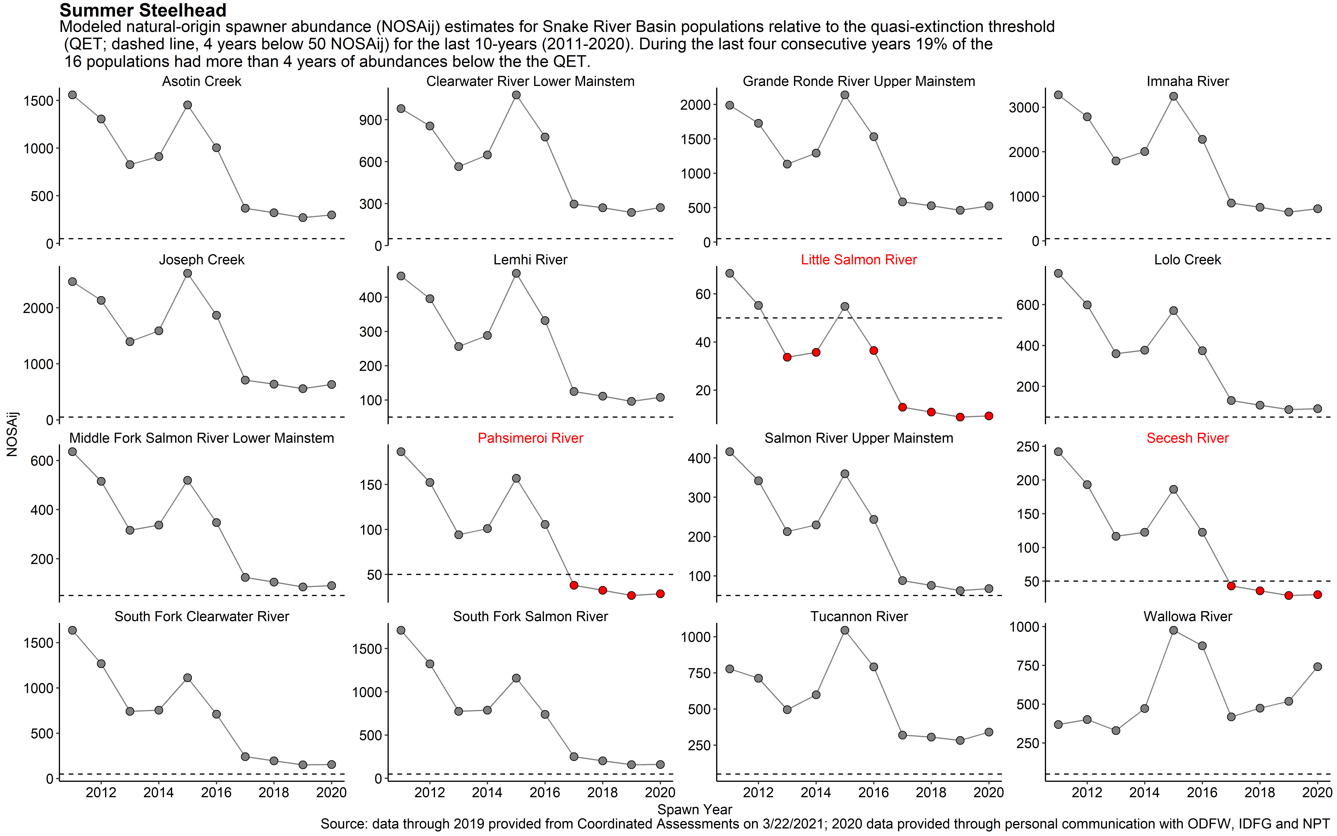
3 (19%) Summer Steelhead Populations
Currently At or Below QET (50)
Snake Basin Chinook and Steelhead Quasi-Extinction Threshold Alarm and Call to Action
Presented to Northwest Power and Conservation Council May 5, 2021
Nez Perce Tribe Department of Fisheries Resources Management

Slide 16
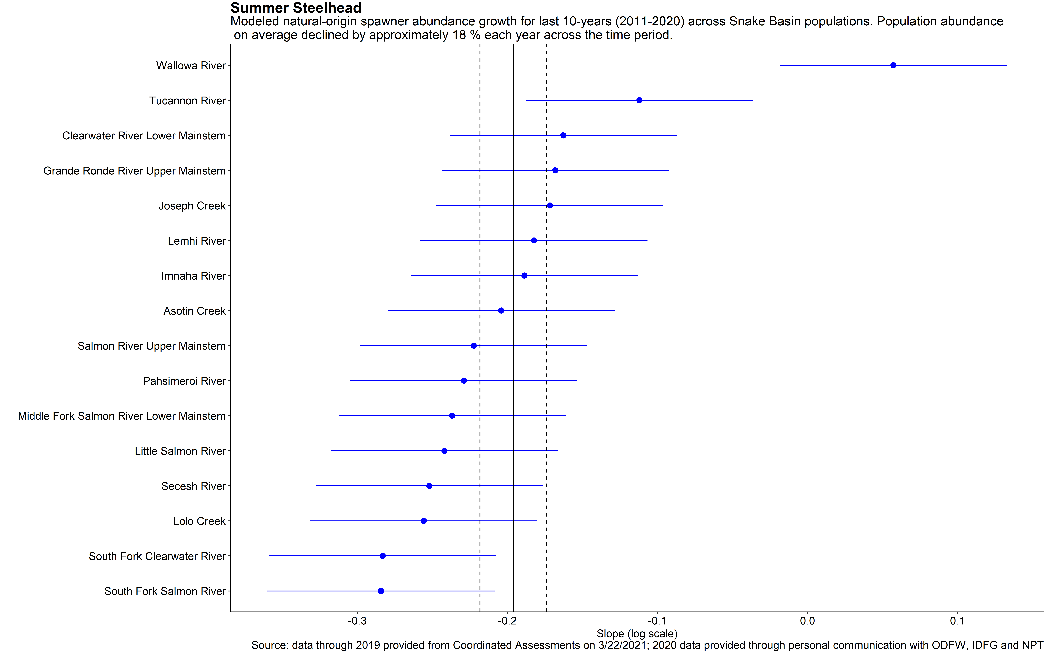
Abundance Declining 18% Each Year
B-run Populations Declining at Faster Rate
Summer Steelhead
Snake Basin Chinook and Steelhead Quasi-Extinction Threshold Alarm and Call to Action
Presented to Northwest Power and Conservation Council May 5, 2021
Nez Perce Tribe Department of Fisheries Resources Management

Slide 17
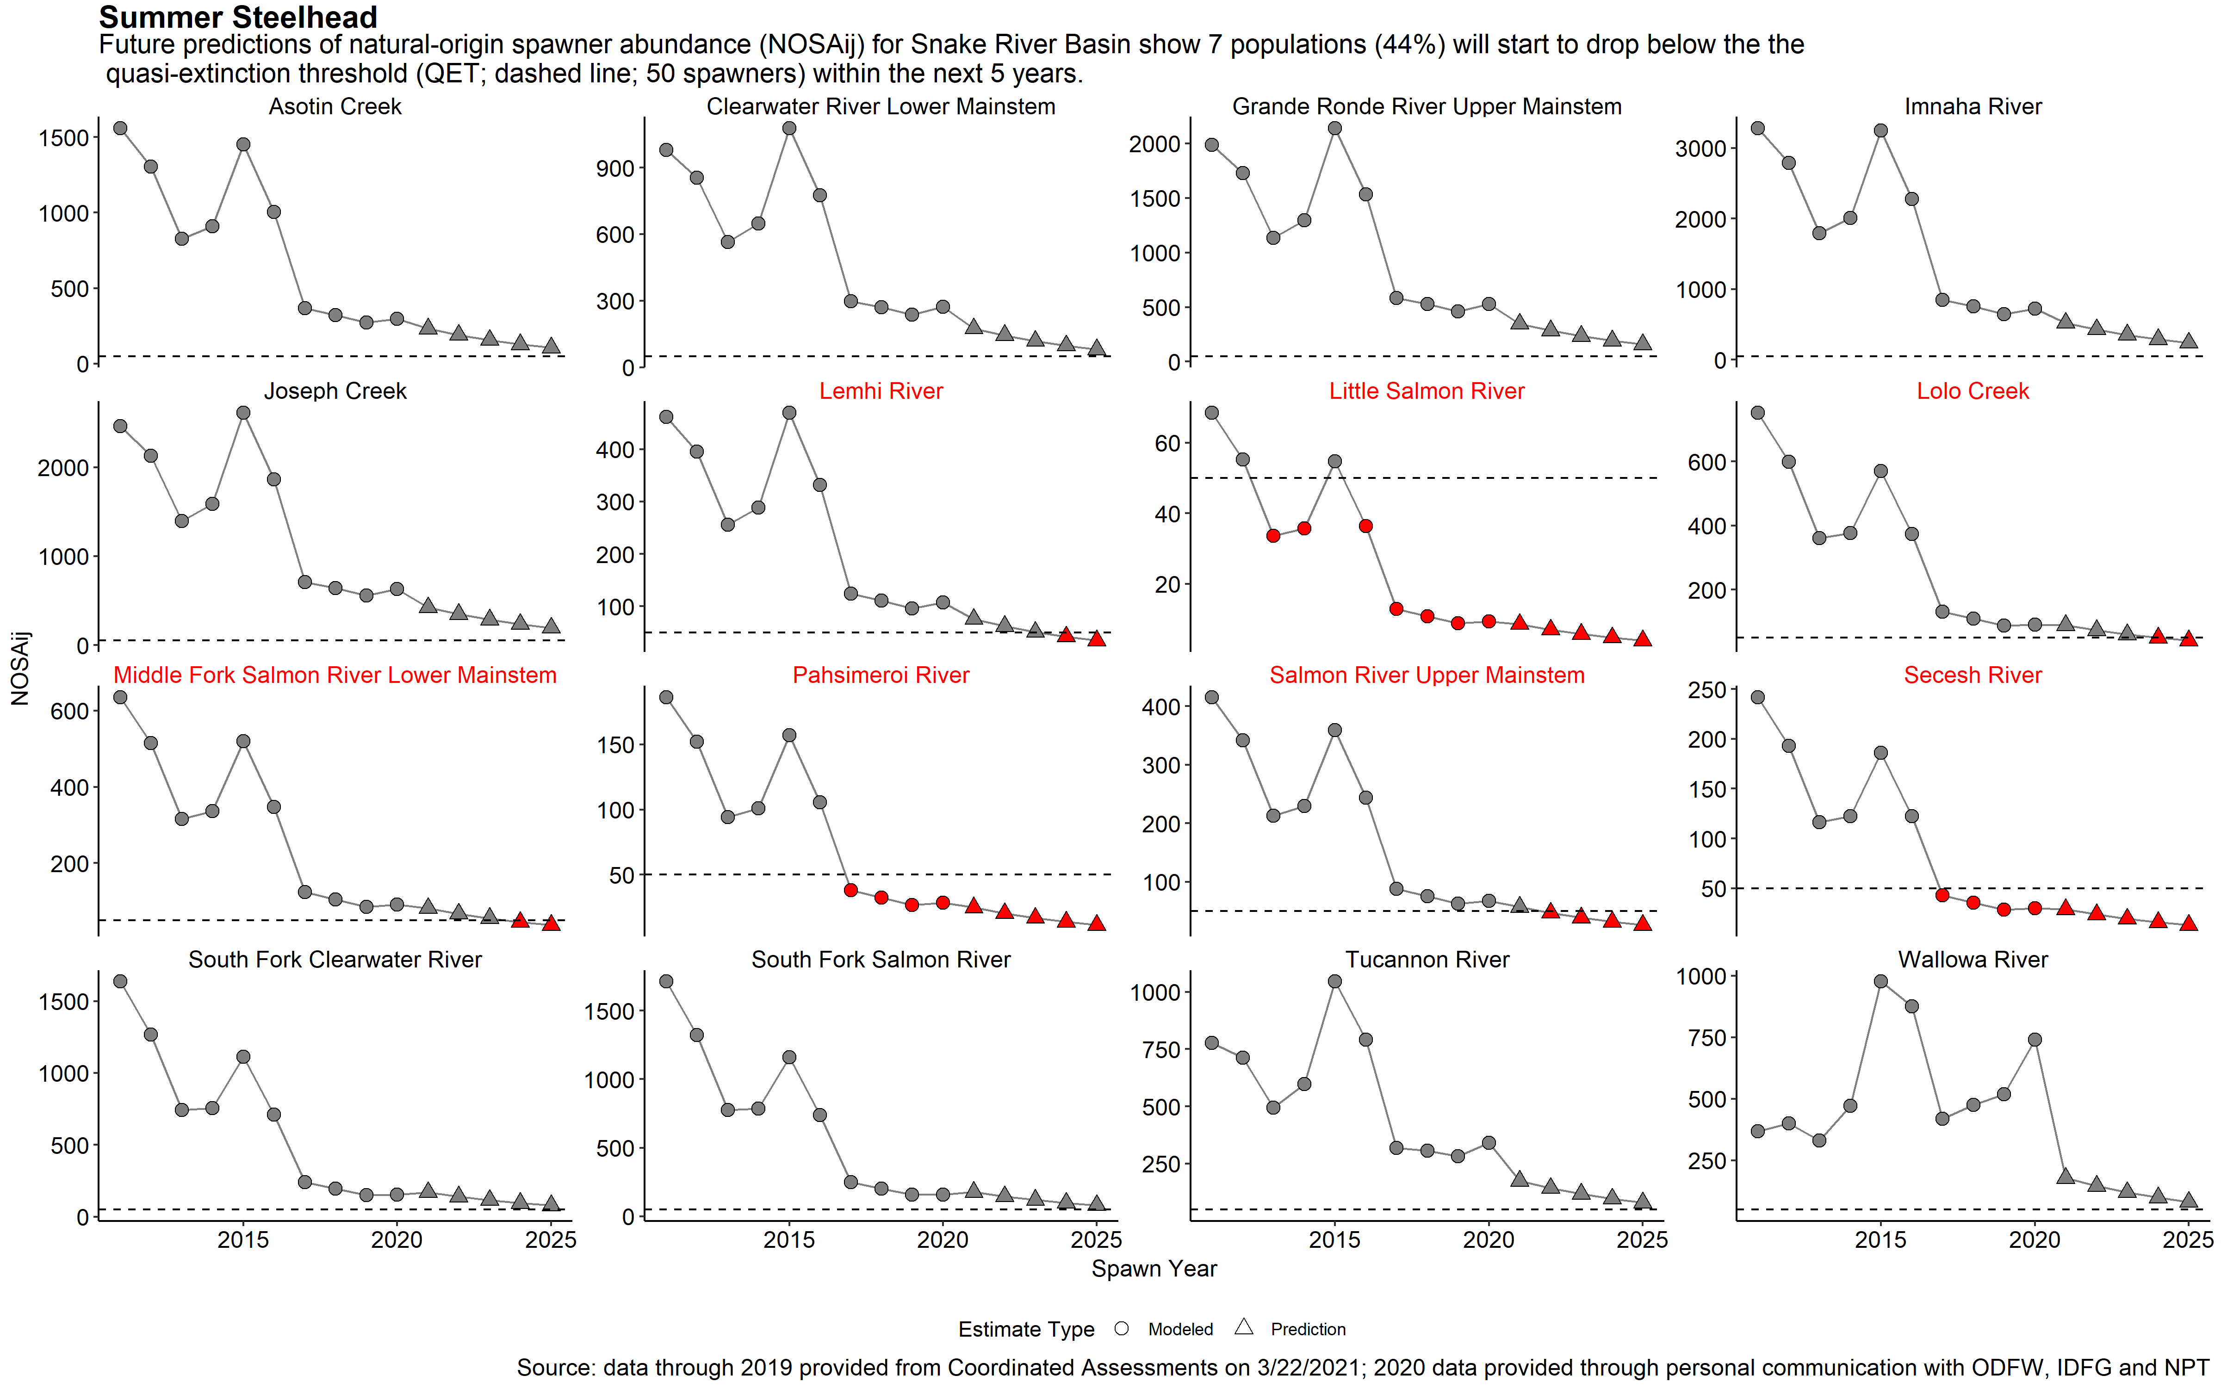
7 (44%) Summer Steelhead Populations
Predicted to Be At or Below 50 spawners by 2025
Snake Basin Chinook and Steelhead Quasi-Extinction Threshold Alarm and Call to Action
Presented to Northwest Power and Conservation Council May 5, 2021
Nez Perce Tribe Department of Fisheries Resources Management

Slide 18
Challenging Environment Ahead
Urgency needed as at risk populations already well below forecasted abundance
Snake Basin Chinook and Steelhead Quasi-Extinction Threshold Alarm and Call to Action
Presented to Northwest Power and Conservation Council May 5, 2021
Nez Perce Tribe Department of Fisheries Resources Management
Fig. 4 - Crozier et al. 2021 (modified with actual 2019 abundance - indicated by black dots ).

Slide 19
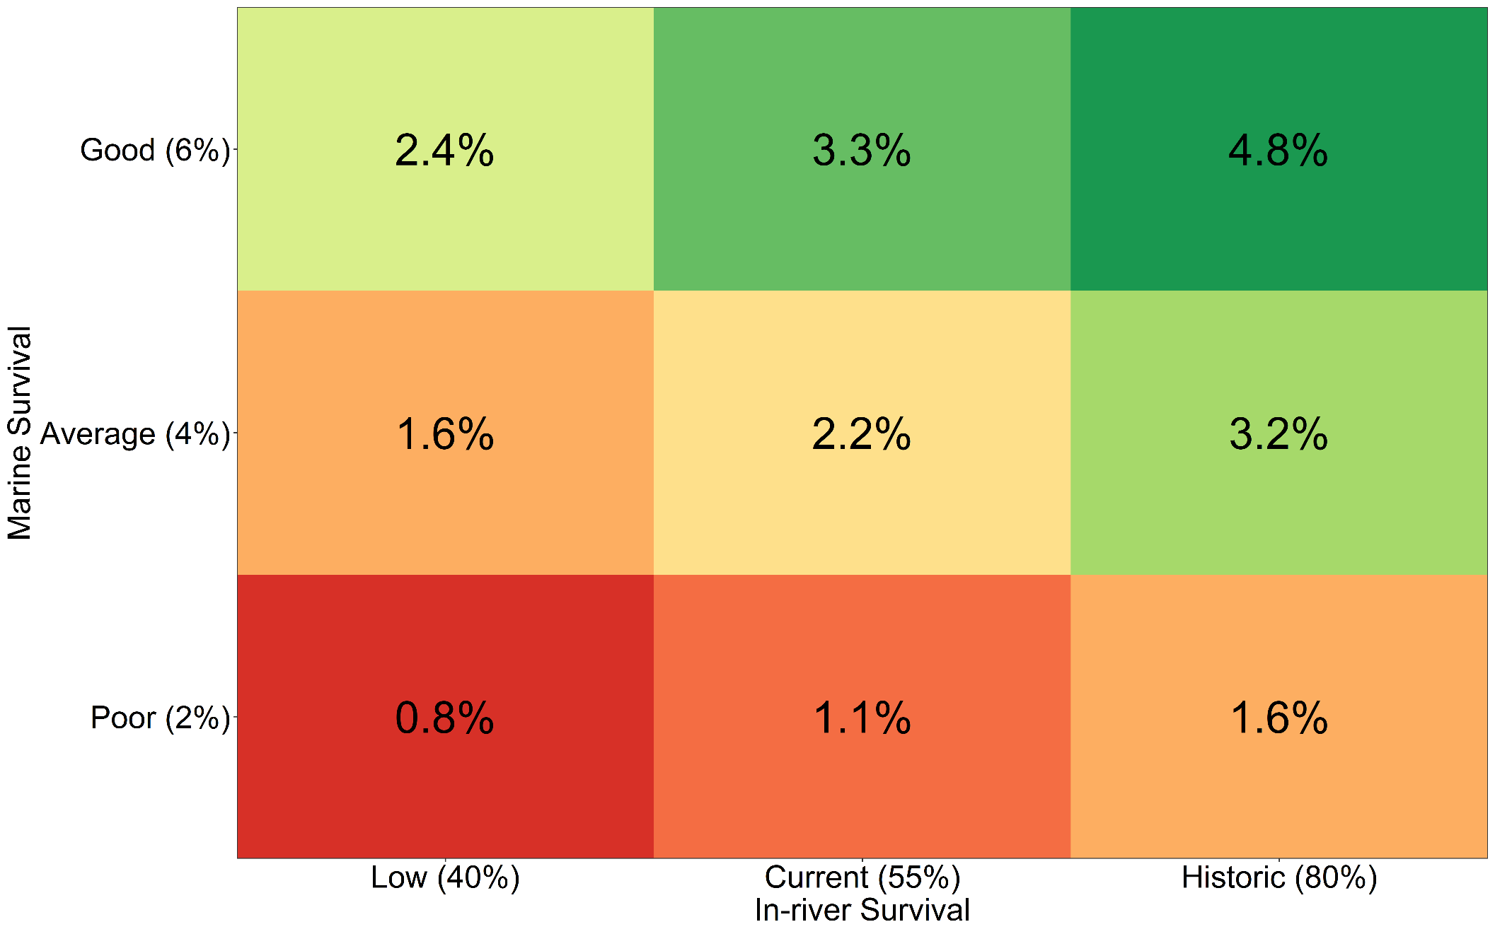
Mainstem Survival Has Direct Effect
on SARs and Number of Returning Adults
(Generalized Example)
Snake Basin Chinook and Steelhead Quasi-Extinction Threshold Alarm and Call to Action
Presented to Northwest Power and Conservation Council May 5, 2021
Nez Perce Tribe Department of Fisheries Resources Management

Slide 20
At-Risk Populations
Spring/summer Chinook
13 (42%) currently at or below QET (50) (highlighted yellow in table).
19 (61%) at or below 50 spawners in at least one year since 2017.
24 (77%) predicted to be at or below 50 by 2025 (red text in table).
Snake Basin Chinook and Steelhead Quasi-Extinction Threshold Alarm and Call to Action
Presented to Northwest Power and Conservation Council May 5, 2021
Nez Perce Tribe Department of Fisheries Resources Management

Slide 21
Call to Action
Multiple factors contributing to low abundance.
Improving survival at multiple life stages needed.
Maximizing freshwater survival during periods of poor ocean conditions paramount.
Seek actions sufficient to address current crisis and help salmon thrive – Simpson solution.
Snake Basin Chinook and Steelhead Quasi-Extinction Threshold Alarm and Call to Action
Presented to Northwest Power and Conservation Council May 5, 2021
Nez Perce Tribe Department of Fisheries Resources Management

Slide 22
Bonus Slides
Snake Basin Chinook and Steelhead Quasi-Extinction Threshold Alarm and Call to Action
Presented to Northwest Power and Conservation Council May 5, 2021
Nez Perce Tribe Department of Fisheries Resources Management

Slide 23
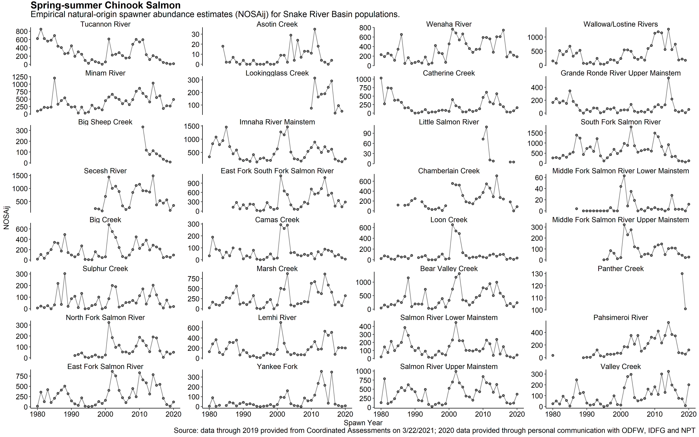
Empirical Population Specific Abundance
Spring/summer Chinook
Snake Basin Chinook and Steelhead Quasi-Extinction Threshold Alarm and Call to Action
Presented to Northwest Power and Conservation Council May 5, 2021
Nez Perce Tribe Department of Fisheries Resources Management

Slide 24
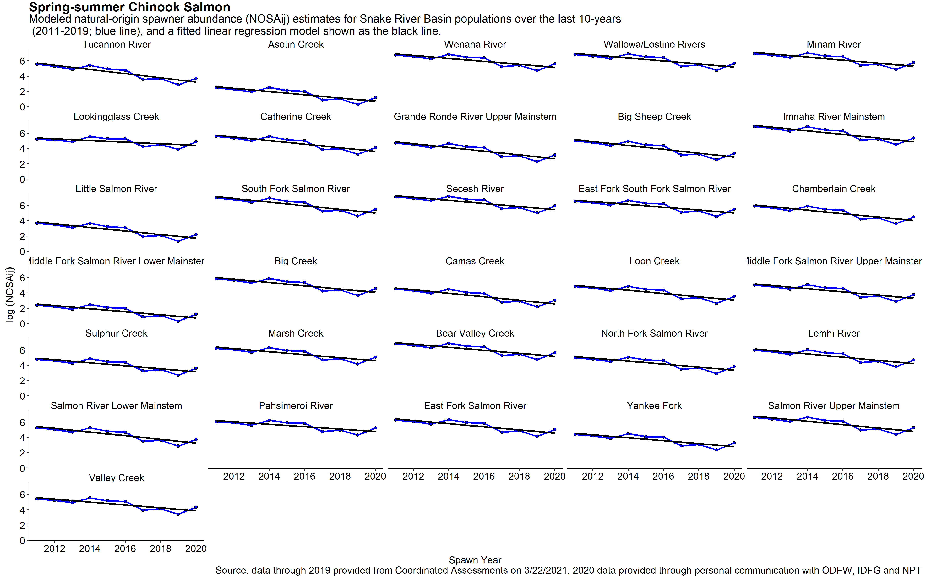
Populations in Decline Over Last 10 Years
Spring/summer Chinook
Snake Basin Chinook and Steelhead Quasi-Extinction Threshold Alarm and Call to Action
Presented to Northwest Power and Conservation Council May 5, 2021
Nez Perce Tribe Department of Fisheries Resources Management

Slide 25
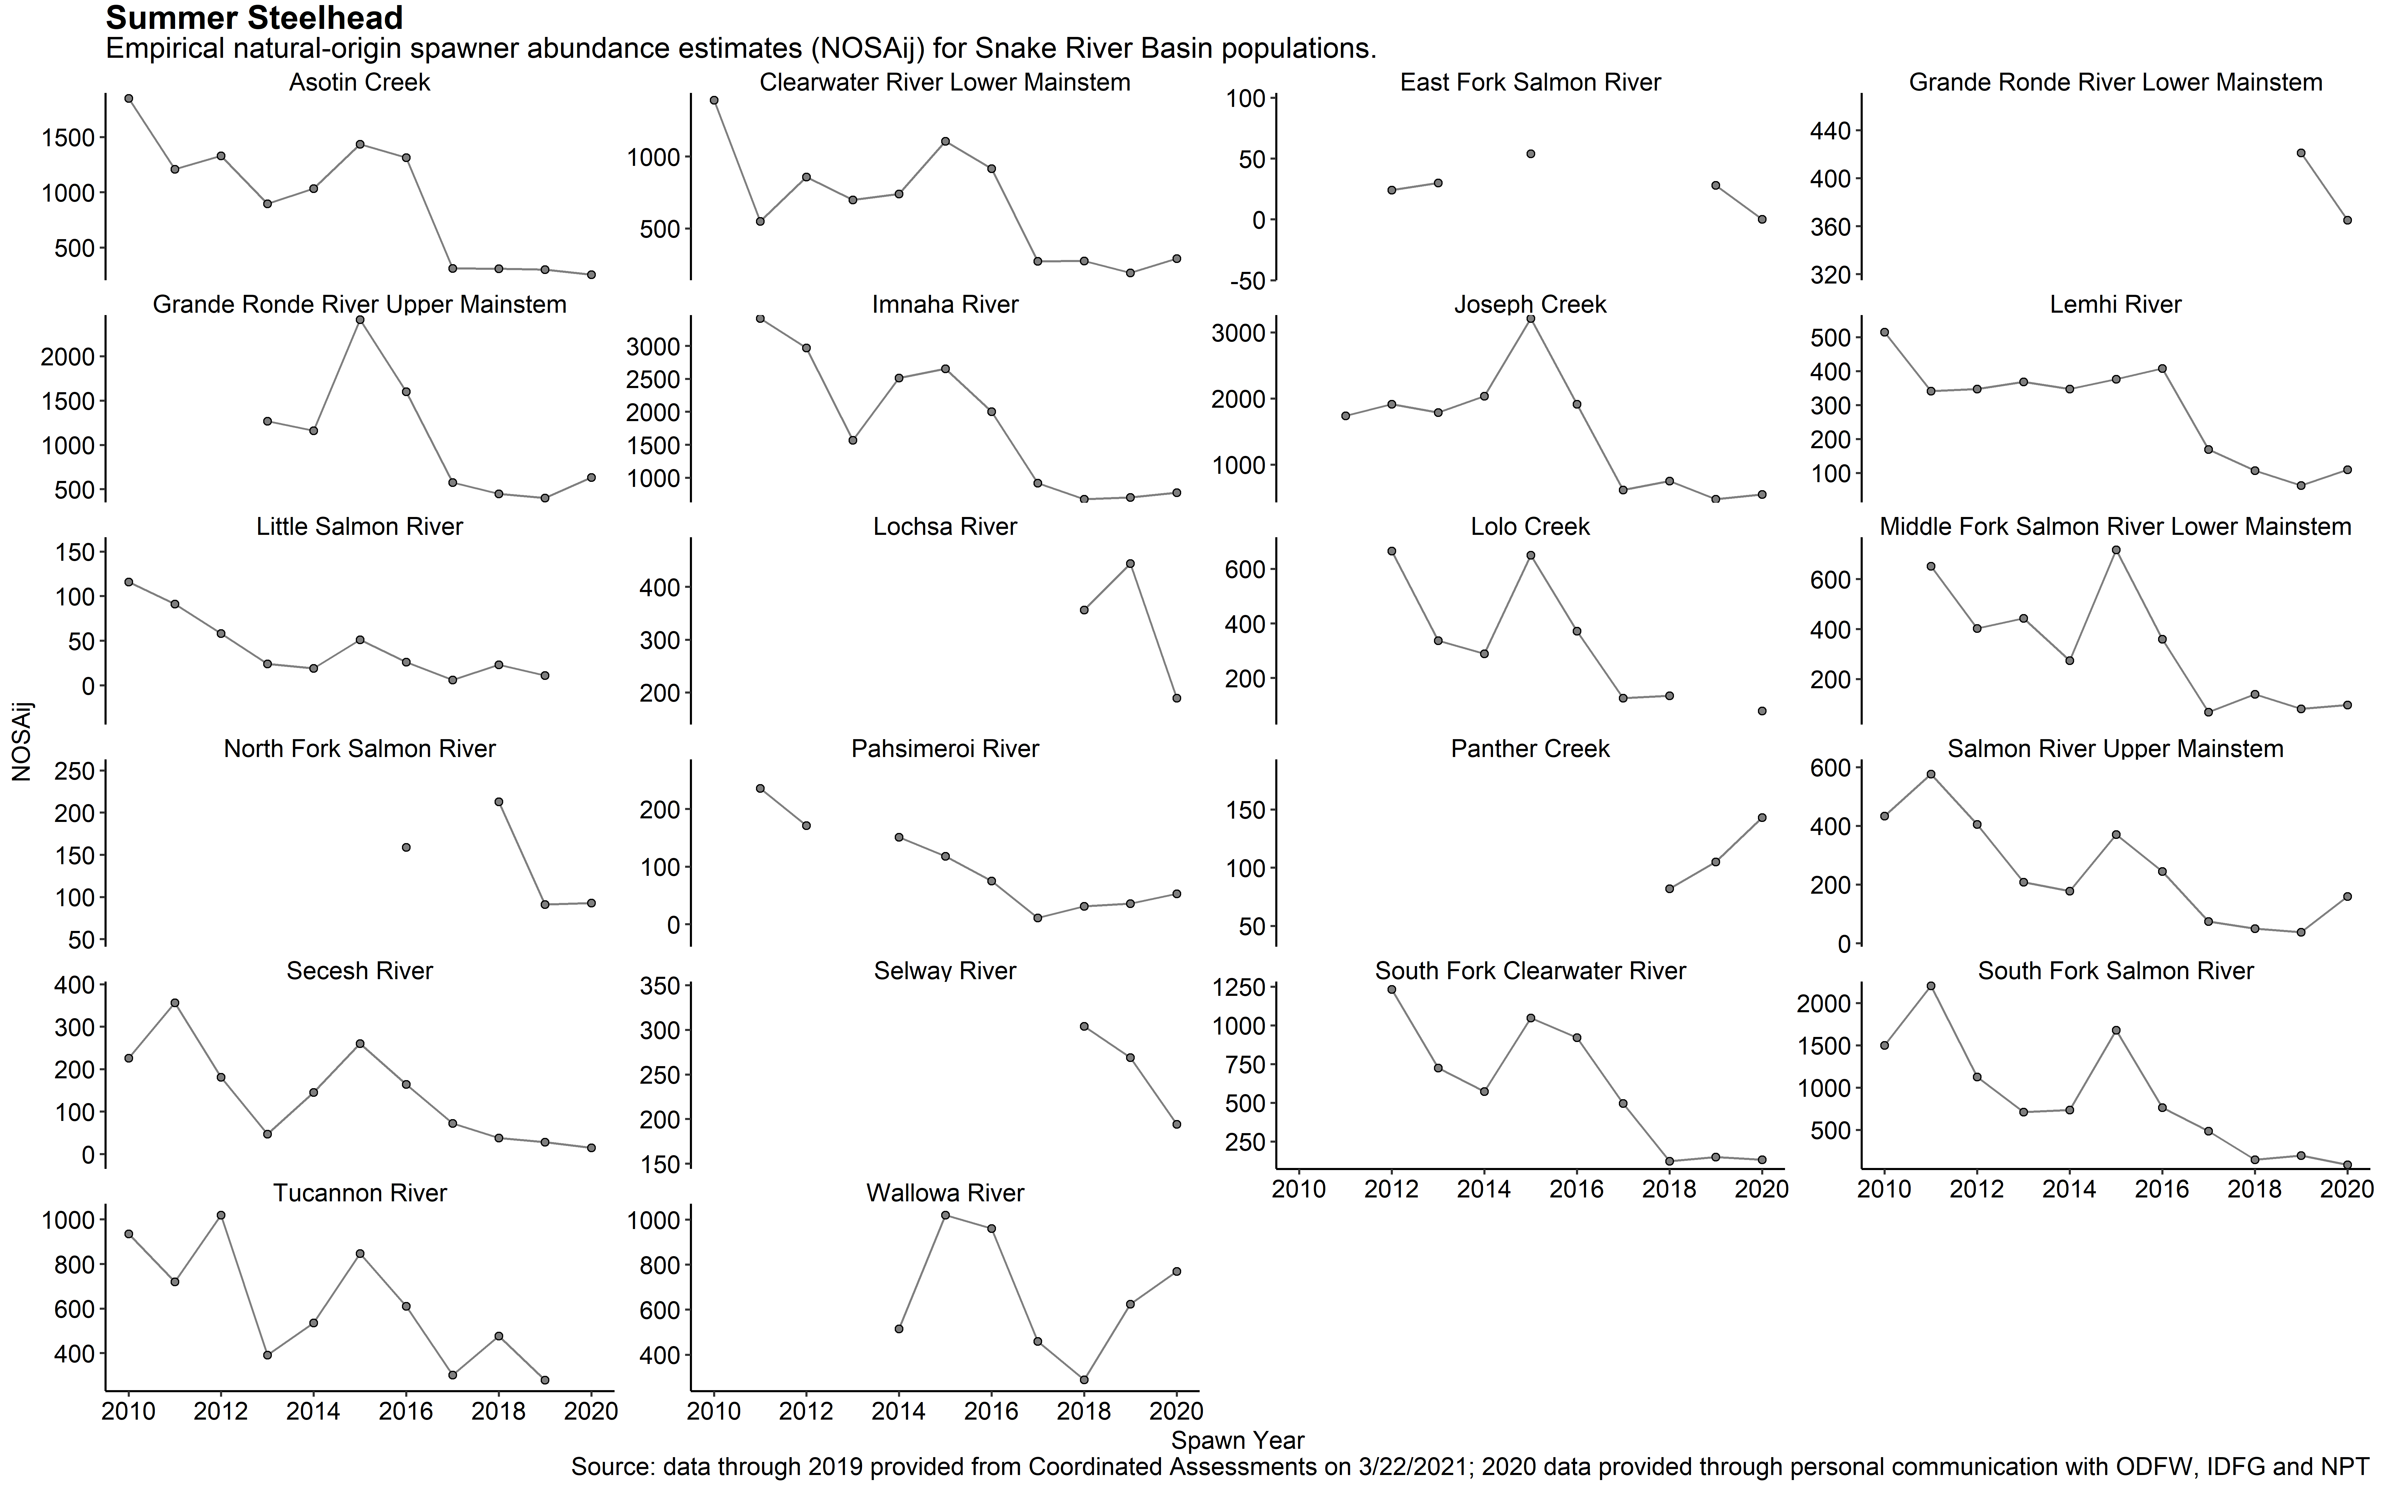
Empirical Population Specific Abundance
Summer Steelhead
Snake Basin Chinook and Steelhead Quasi-Extinction Threshold Alarm and Call to Action
Presented to Northwest Power and Conservation Council May 5, 2021
Nez Perce Tribe Department of Fisheries Resources Management

Slide 26
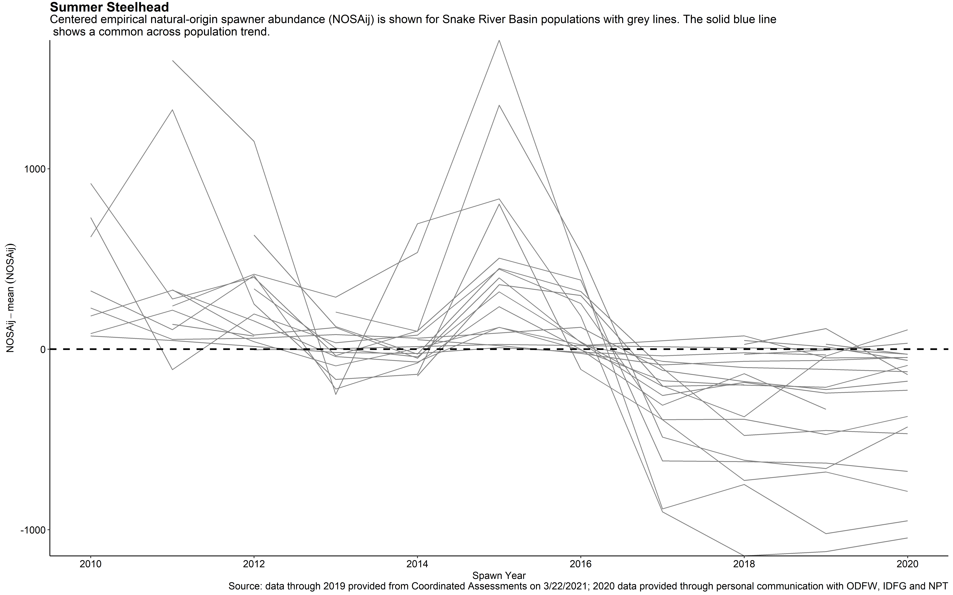
Synchrony Across Populations
Summer Steelhead
Snake Basin Chinook and Steelhead Quasi-Extinction Threshold Alarm and Call to Action
Presented to Northwest Power and Conservation Council May 5, 2021
Nez Perce Tribe Department of Fisheries Resources Management

Slide 27
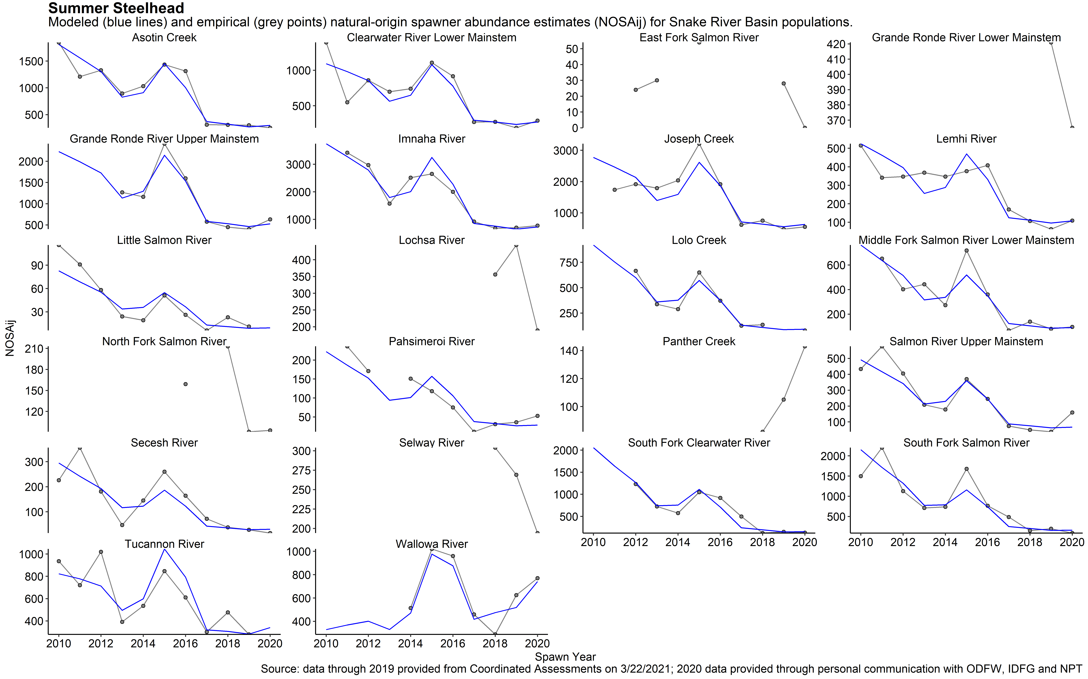
Abundance Fits Common Model
Steelhead
Snake Basin Chinook and Steelhead Quasi-Extinction Threshold Alarm and Call to Action
Presented to Northwest Power and Conservation Council May 5, 2021
Nez Perce Tribe Department of Fisheries Resources Management

Slide 28
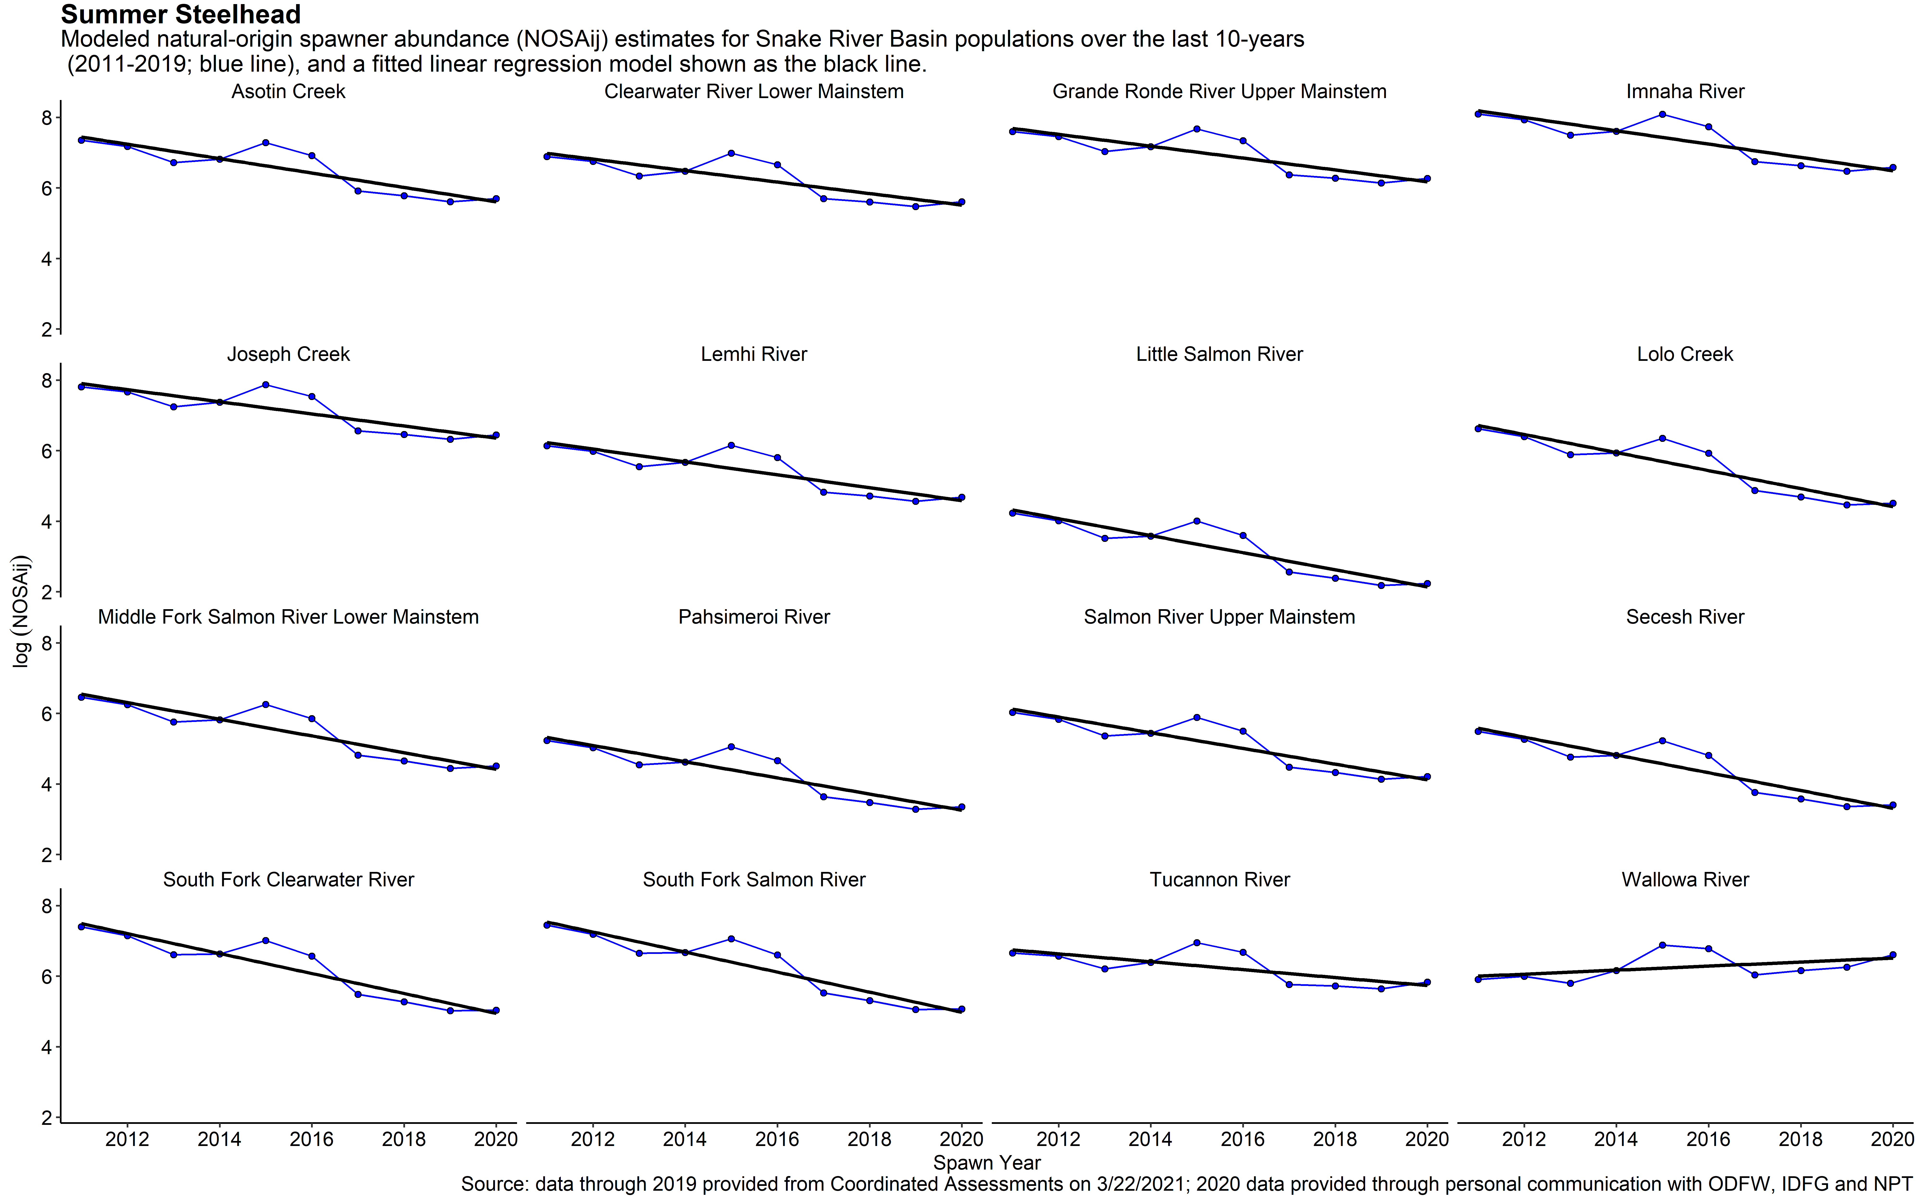
Most Populations in Decline Over Last 10 Years
Summer Steelhead
Snake Basin Chinook and Steelhead Quasi-Extinction Threshold Alarm and Call to Action
Presented to Northwest Power and Conservation Council May 5, 2021
Nez Perce Tribe Department of Fisheries Resources Management

